Slide 1
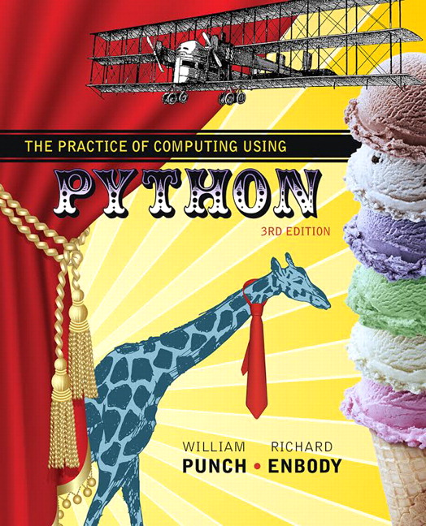
The Practice of Computing Using Python
Third Edition
Chapter 12
More on Classes
Copyright © 2017, 2013, 2011 Pearson Education, Inc. All Rights Reserved
Notes:
If this PowerPoint presentation contains mathematical equations, you may need to check that your computer has the following installed:
1) MathType Plugin
2) Math Player (free versions available)
3) NVDA Reader (free versions available)

Slide 2
The three O O P factors
Remember, we said there were 3 factors that distinguished an Object Oriented Programming langauge:
encapsulation
inheritance
polymorphism

Slide 3
We are Still at Encapsulation
We said that encapsulation:
hid details of the implementation so that the program was easier to read and write
modularity, make an object so that it can be reused in other contexts
providing an interface (the methods) that are the approved way to deal with the class

Slide 4
One More Aspect
A new aspect we should have is consistency
Remember Rule 9: Do the right thing
A new class should be consistent with the rules of the language.
It should respond to standard messages, it should behave properly with typical functions (assuming the type allows that kind of call).

Slide 5
An example
Consider a Rational number class. It should respond to:
construction
printing
arithmetic ops (+, -, *, /)
comparison ops

Slide 6
Example Program

Slide 7
Just Like Any Other Number
by building the class properly, we can make a new instance of Rational look like any other number syntactically.
the instance responds to all the normal function calls
because it is properly encapsulated, it is much easier to use

Slide 8
But how Can that Work?
Two parts:
Python can distinguish which operator to use based on types
Python provides more standard methods that represent the action of standard functions in the language
by defining them in our class, Python will call them in the “right way”

Slide 9
More on Type
As we have mentioned, a class is essentially a new type
when we make an instance of a class, we have made an object of a particular type
1.36 is a float

Slide 10
Introspection
Python does not have a type associated with any variable, since each variable is allowed to reference any object
however, we can query any variable as to what type it presently references
this is often called introspection. That is, while the program is running we can determine the type a variable references

Slide 11
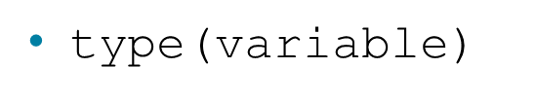
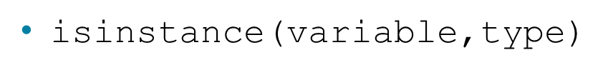
Python introspection ops
returns its type as an object
returns a boolean indicating if the variable is of that type

Slide 12
Code Listing 12.1

Slide 13
Operator Overloading

Slide 14
So What Does var1+var2 Mean?
The answer:
it depends
What it depends on is the type. The + operation has two operands. What are their types?
Python uses introspection to find the type and then select the correct operator

Slide 15
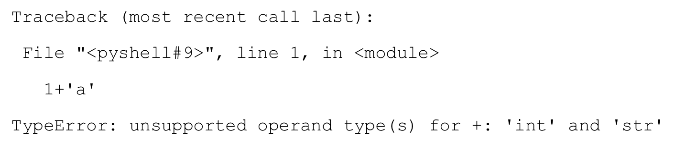
We've Seen This Before
What does var1+var2 do?
with two strings, we get concatenation
with two integers, we get addition
with an integer and a string we get:

Slide 16
Operator Overloading
the plus operator is overloaded
that is, the operator can do/mean different things (have multiple/overloaded meanings) depending on the types involved
if python does not recognize the operation and that combination of types, you get an error

Slide 17
Python Overload ops
Python provides a set of operators that can be overloaded. You can't overload all the operators, but you can many
Like all the special class operations, they use the two underlines before and after They come in three general classes:
numeric type operations (+,-,<,>,print etc.)
container operations ([ ], iterate,len, etc.)
general operations (printing, construction)

Slide 18
Table 12.1 Python Special Method Names

Slide 19
Code Listing 12.2

Slide 20
How Does V1+v2 Map to __Add__
v1 + v2
is turned, by Python, into
v1.__add__(v2)
These are exactly equivalent expressions. It means that the first variable calls the __add__ method with the second variable passed as an argument
v1 is bound to self, v2 bound to param2

Slide 21
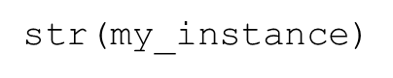
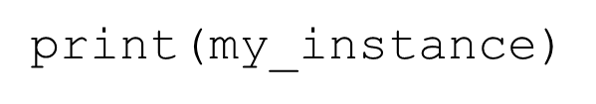
Calling __str__
When does the __str__ method get called? Whenever a string representation of the instance is required:
directly, by saying
indirectly, calling

Slide 22
Simple Rational Number Class
a Rational is represented by two integers, the numerator and the denominator
we can apply many of the numeric operators to Rational

Slide 23
Code Listing 12.3

Slide 24
__str__ vs __repr__
__repr__ is what the interpreter will call when you type an instance
potentially, the representation of the instance, something you can recreate an instance from.
__str__ is a conversion of the instance to a string.
Often we define __str__, have __repr__ call __str__
note the call: self.__str__()

Slide 25
the __init__ method
each instance gets an attribute numer and denom to represent the numerator and denominator of that instance's values

Slide 26
Provide Addition
Remember how we add fractions:
if the denominator is the same, add the numerators
if not, find a new common denominator that each denominator divides without remainder.
modify the numerators and add

Slide 27
The L c m and G c d
the least common multiple (L c m ) finds the smallest number that each denominator divides without remainder
the greatest common divisor (G c d) finds the largest number two numbers can divide into without remainder

Slide 28
L C mM in terms of G C D
OK, how to find the gcd then?

Slide 29
G C D and Euclid
One of the earliest algorithms recorded was the G C D by Euclid in his book Elements around 300 B.C.
He originally defined it in terms of geometry but the result is the same

Slide 30
The Algorithm
G C D(a,b)
If one of the numbers is 0, return the other and halt
Otherwise, find the integer remainder of the larger number divided by the smaller number
Reapply G C D(a,b) with a ← smaller and b← the remainder from step 2)

Slide 31
Code Listing 12.4

Slide 32
Code Listing 12.5

Slide 33
Code Listing 12.6

Slide 34
Equality
The equality method is __eq__
It is invoked with the == operator
It should be able to deal with non-reduced fractions:

Slide 35
Code Listing 12.7

Slide 36
Fitting in
What is amazing about the traces of these methods is how many of them are called in service of the overall goal.
All we did was provide the basic pieces and Python orchestrates how they all fit together!
Rule 9 rules!

Slide 37
What doesn't work

Slide 38
So r1+r2, But What About
We said the add we defined would work for two rationals, but what about?
r1 + 1 # Rational plus an integer
1 + r1 # commutativit
Neither works right now. How to fix?

Slide 39
r1 + 1
What's the problem?
add expects another rational number as the second argument.
Python used to have a coercion operator, but that is deprecated
coerce: force conversion to another type
deprecate: 'disapproval', an approach that is no longer supported
Our constructor would support conversion of an int to a Rational, how/where to do this?

Slide 40
Introspection in __add__
the add operator is going to have to check the types of the parameter and then decide what should be done
if the type is an integer, convert it. If it is a Rational, do what we did before. Anything else that is to be allowed needs to be checked

Slide 41
Code Listing 12.8

Slide 42
What About 1 + r1
What's the problem
mapping is wrong
1 + r1 maps to 1.__add__(r1)
no such method for integers (and besides, it would be a real pain to have to add a new method to every type we want to include)
user should expect that this should work. Addition is commutative!

Slide 43
Radd Method
Python allows the definition of an __radd__ method
The __radd__ method is called when the __add__ method fails because of a type mismatch
__radd__ reverses the two arguments in the call

Slide 44
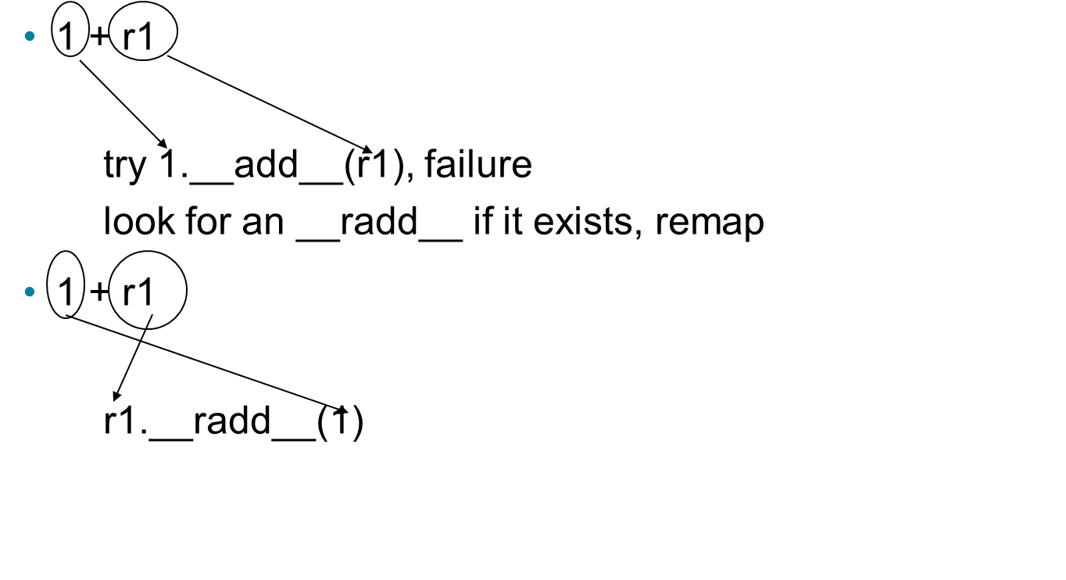
__radd__ vs __add__

Slide 45
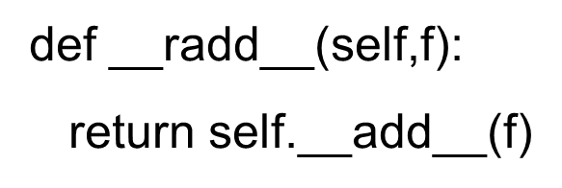
Radd
essentially, all we need __radd__ to do is remap the parameters.
after that, it is just add all over again, so we call __add__ directly
means we only have to maintain __add__ if any changes are required

Slide 46
Inheritance

Slide 47
Class-Instance relations
Remember the relationship between a class and its instances
a class can have many instances, each made initially from the constructor of the class
the methods an instance can call are initially shared by all instances of a class

Slide 48
Class-Class relations
Classes can also have a separate relationship with other classes
the relationships forms a hierarchy
hierarchy: A body of persons or things ranked in grades, orders or classes, one above another

Slide 49
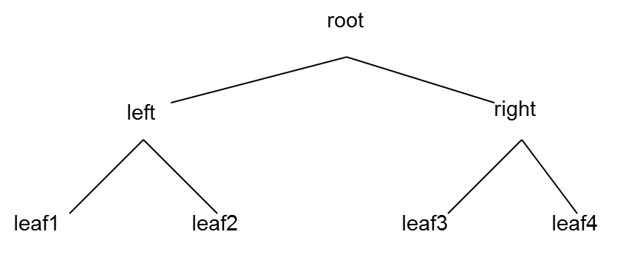
Computer Science ‘Trees’
the hierarchy forms what is called a tree in computer science. Odd ‘tree’ though

Slide 50
Classes Related by a Hierarchy
when we create a class, which is itself another object, we can state how it is related to other classes
the relationship we can indicate is the class that is 'above' it in the hierarchy

Slide 51
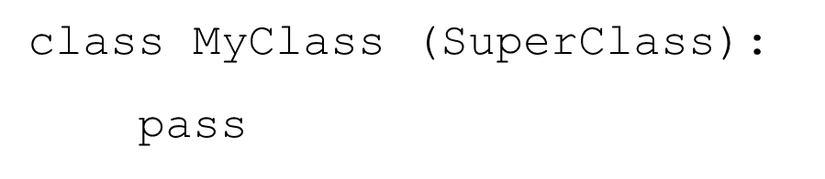
Class Statement
name of the class above
this class in the hierarchy
The top class in Python is called object.
it is predefined by Python, always exists
use object when you have no superclass

Slide 52
Figure 12.1 A Simple Class Hierarchy

Slide 53
Code Listing 12.10

Slide 54
Is-a, Super and Sub Class
the class hierarchy imposes an is-a relationship between classes
MyChildClass is-a (or is a kind of) MyClass
MyClass is-a (or is a kind of) object
object has as a subclass MyClass
MyChildClass has as a superclass MyClass

Slide 55
um, so what?
the hope of such an arrangement is the saving/re-use of code
superclass code contains general code that is applicable to many subclasses
subclass uses superclass code (via sharing) but specializes code for itself when necessary

Slide 56
Scope for Objects, the Full Story
Look in the object for the attribute
If not in the object, look to the object's class for the attribute
If not in the object's class, look up the hierarchy of that class for the attribute
If you hit object, then the attribute does not exist

Slide 57
Figure 12.2 The Players in the “find the attribute” Game

Slide 58
Inheritance is Powerful but also can be Complicated
many powerful aspects of O O P are revealed through uses of inheritance
However, some of that is a bit detailed and hard to work with. Definitely worth checking out but a bit beyond us and our first class

Slide 59
Builtins are Objects Too
One nice way, easy way, to use inheritance is to note that all the builtin types are objects also
thus you can inherit the properties of builtin types then modify how they get used in your subclass
you can also use any of the types you pull in as modules

Slide 60
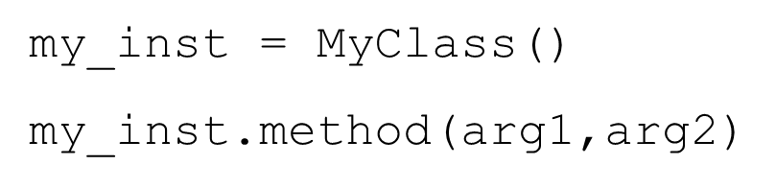
Specializing a Method
One technical detail. Normal method calls are called bound methods. Bound methods have an instance in front of the method call and automatically pass self
is an instance, so the method is bound

Slide 61
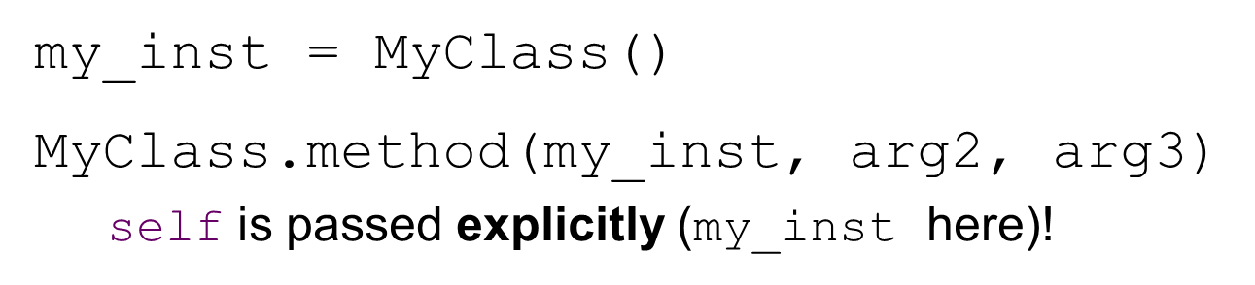
Unbound Methods
it is also possible to call a method without Python binding self. In that case, the user has to do it.
unbound methods are called as part of the class but self passed by the user

Slide 62
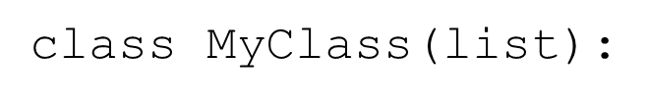
Why???
Consider an example. We want to specialize a new class as a subclass of list.
easy enough, but we want to make sure that we get our new class instances initialized the way they are supposed to, by calling __init__ of the super class

Slide 63
Why Call the Super Class Init?
If we don't explicitly say so, our class may inherit stuff from the super class, but we must make sure we call it in the proper context. For example, our __init__ would be:
def __init__(self):
list.__init__(self)
# do anything else special to MyClass

Slide 64
Explicit Calls to the Super
we explicitly call the super class constructor using an unbound method (why not a bound method????)
then, after it completes we can do anything special for our new class
We specialize the new class but inherit most of the work from the super. Very clever!

Slide 65
Gives us a Way to Organize Code
specialization. A subclass can inherit code from its superclass, but modify anything that is particular to that subclass
over-ride. change a behavior to be specific to a subclass
reuse-code. Use code from other classes (without rewriting) to get behavior in our class.

Slide 66
Reminder, Rules so Far (1 of 2)
Think before you program!
A program is a human-readable essay on problem solving that also happens to execute on a computer.
The best way to imporve your programming and problem solving skills is to practice!
A foolish consistency is the hobgoblin of little minds

Slide 67
Reminder, Rules so Far (2 of 2)
Test your code, often and thoroughly
If it was hard to write, it is probably hard to read. Add a comment.
All input is evil, unless proven otherwise.
A function should do one thing.
Make sure your class does the right thing.

Slide 68
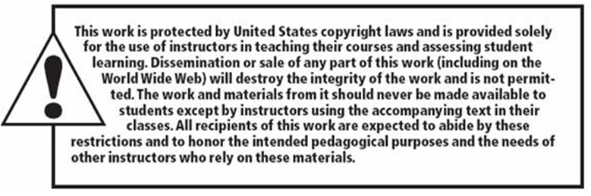
Copyright

